Slide 1


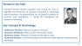
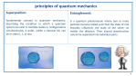
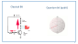
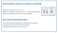
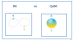

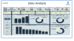

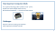


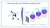



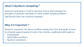

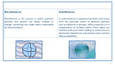
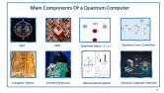
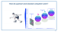
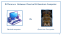

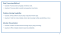
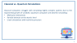



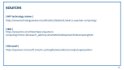


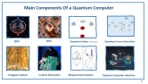



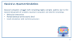


Super Store Sales

Slide 2

Dashboard Analysis
Agenda
DATA Overview
Data Cleaning
Data modeling
Measures
Key Insights & Recommendations
Project Overview

Slide 3

Team Members
Belal Mohamed
Abdelrahman Mohamed
Ahmed Magdy
Mohamed Mostafa
Youssef Mohamed
Mohamed Magdy

Slide 4
Dashboard Analysis
Project Overview
Super Store Sales Data Analysis Project
We aim to cover trends in product categories, shipping methods, regional performance, and customer behavior.

Slide 5

Dashboard Analysis
Data Overview
Records: 9800
Total Attributes: 18
3 Numeric: Row ID, Postal Code, Sales
2 Date columns (Order Date, Ship Date)
13 Categorical columns (e.g., Customer Name, Product Category)

Slide 6

Dashboard Analysis
Data Cleaning
Handled missing values (by filling or removing)
Corrected data types (dates, numbers, etc.)
Fixed inconsistent entries (e.g. gender format, typos)
Filtered out irrelevant/outlier data
Tools used: Excel / Power Query
Result: Clean and reliable data ready for analysis

Slide 7
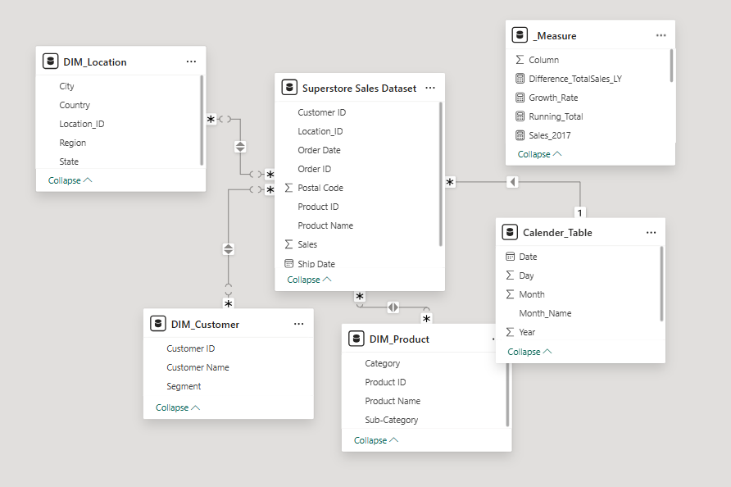
lysis
Data Model & Preprocessing
Data Import
Imported store sales CSV data into Power BI
Data Cleaning
Applied transformations: type changes, text formatting, and filtering empty values
Dimensions
Created customer, product, and location dimensions for better organization
Data Modeling
Built relationships between tables and created calendar table for date analysis

Slide 8
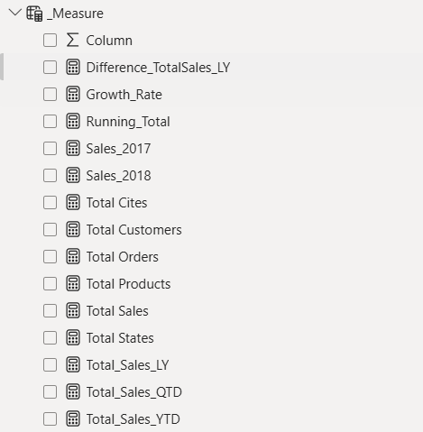
s
Measures
Core Metrics for Data-Driven Decisions“
Why They Matter:
Turn raw data into actionable business insights.
Enable apples-to-apples comparisons (YoY, MoM).
Visual Suggestion:
Dashboard snippet with these measures highlighted.

Slide 9
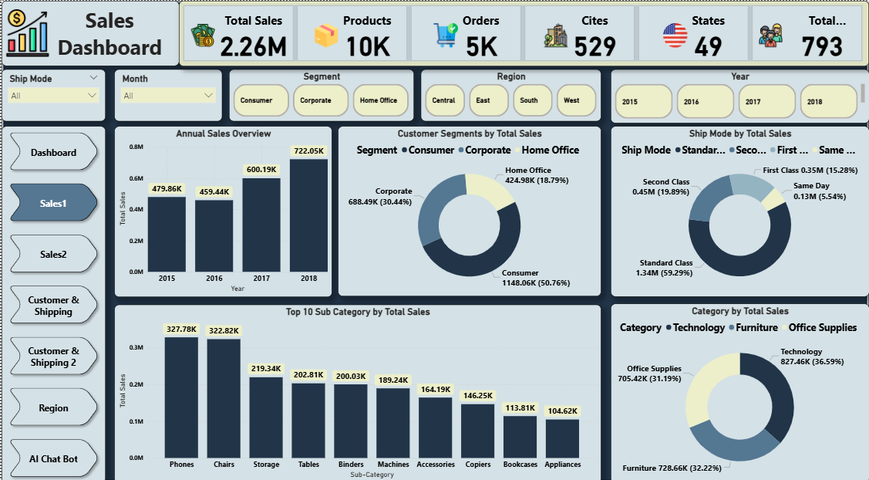
lysis
Sales Analysis

Slide 10
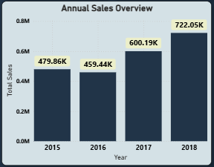
lysis
Annual Sales Overview
Annual Sales Overview (2015-2018 Performance)
Total Growth: 479K➔479K➔722K (+50.6% over 4 years)
Record Year: 2018 achieved peak sales ($722K) Potential drivers: New product launches/expanded market reach
Key Insight: Consistent YOY growth suggests effective strategies
Recommendation: ✓ Replicate top-performing initiatives ✓ Set 2024 target of $800K+

Slide 11
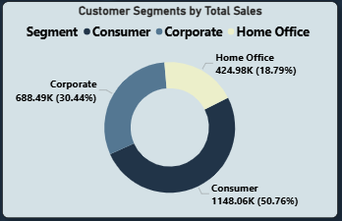
lysis
Revenue by Customer Type
Customer Segments
Consumer Segment drives 50.76% of total sales ($1.14M).
Opportunity: Corporate (30.44%) has room for growth—target B2B campaigns.
Quote: "Personalized offers could boost Home Office (18.79%) revenue."

Slide 12
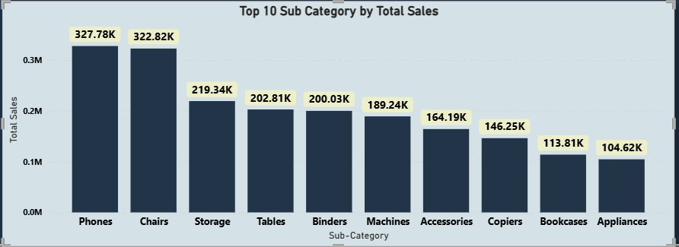
lysis
Top-Performing Products
Phones and Chairs dominate sales (highest bars in chart).
Spot: Binders and Machines underperform—consider promotions or inventory review.

Slide 13
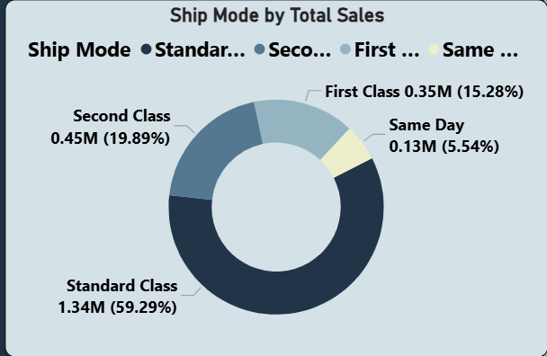
lysis
Shipping Mode Analysis
59.29% of orders use Standard Class—balance cost vs. speed.
Low Priority: Same Day (5.54%) is least popular—evaluate if worth offering.

Slide 14
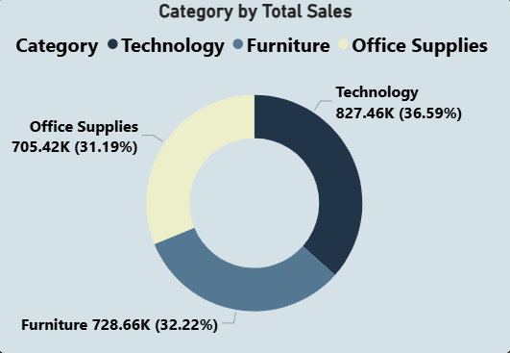
lysis
Sales by Category
Near-even split: Technology (36.59%), Furniture (32.22%), Office Supplies (31.19%).
Action Item: Bundle products (e.g., Tech + Furniture) to increase average order value.

Slide 15
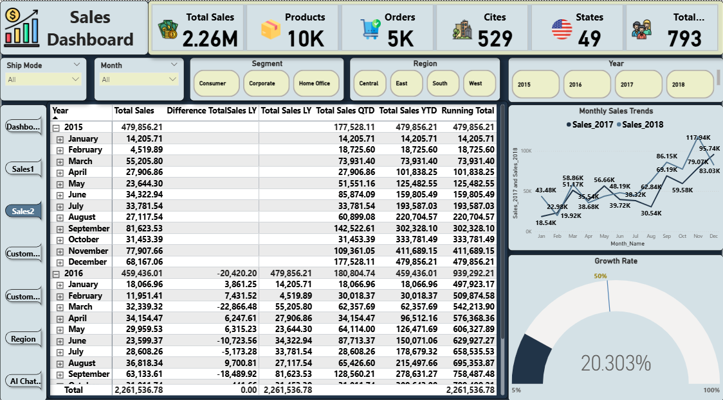
lysis
Sales Analysis

Slide 16

lysis
Annual Sales Trend
Yearly Performance (2015-2018)
Data Breakdown:
2015: $479K (Baseline)
2016: Dip to $459K (-4.3%)
2017: Recovery to $600K (+30.6% YoY)
2018: Peak at $722K (+20.3% YoY)

Slide 17
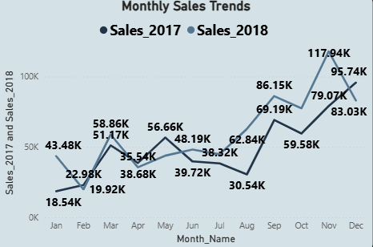
lysis
Monthly Sales Patterns
Monthly Trends: 2017 vs. 2018
Consistent Growth: 2018 out performed 2017 in 11/12 months.
Top Months:
September 2018: $81.6K (highest single month)
Q4 2018: Strong performance (Oct-Dec = $177.5K)
Low Months: February averages $8.2K (critical gap).

Slide 18
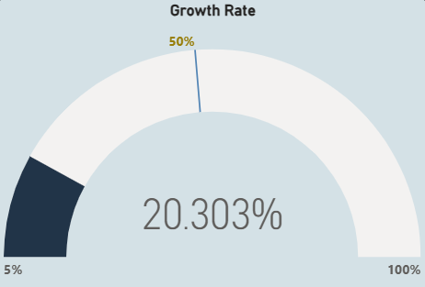
lysis
Growth Rate
Growth : 2017 , 2018
20.3% Growth: Strong recovery from 2017’s.
Peak Performance: 2018 is the best year in your dataset.

Slide 19
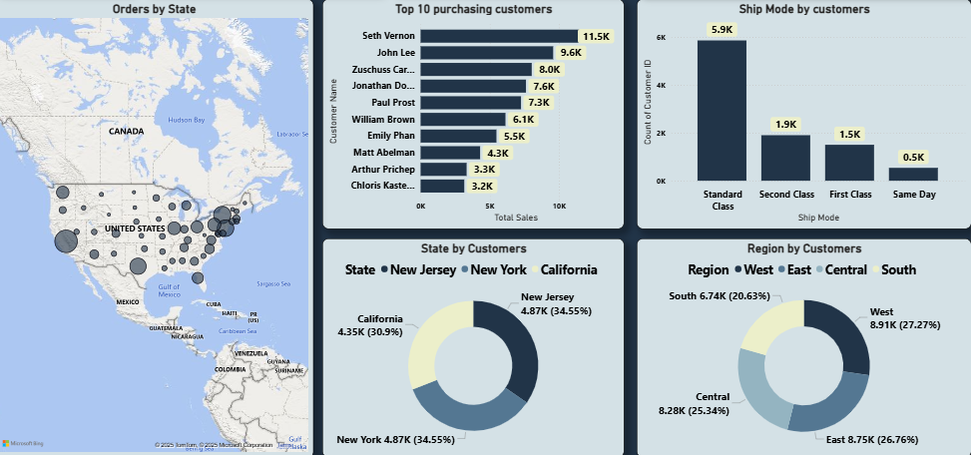
lysis
Customer & Shipping

Slide 20
lysis
Customer & Shipping
Top States
New York & New Jersey dominate: 34.55% each of total orders.
California: 30.9% (3rd highest).
2. Key Customers
Seth Vernon & John Lee are top purchasers (9.6K/8.0K sales).
Top 10 customers contribute significantly—focus on retention.
3. Shipping & Regions
Shipping: Standard Class (5.9K orders) is most popular.
Regions: West (27.27%) and East (26.76%) lead demand.

Slide 21
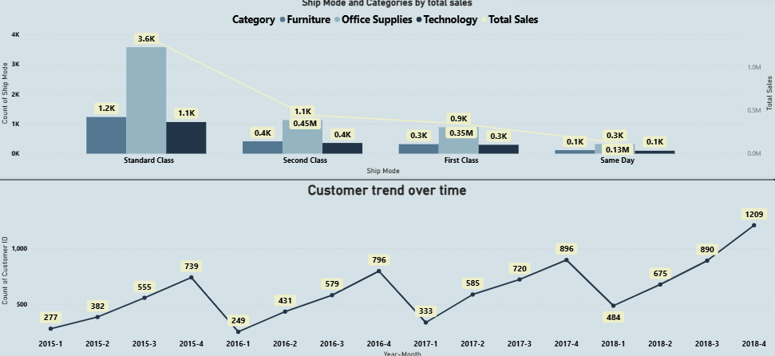
lysis
Customer & Shipping

Slide 22
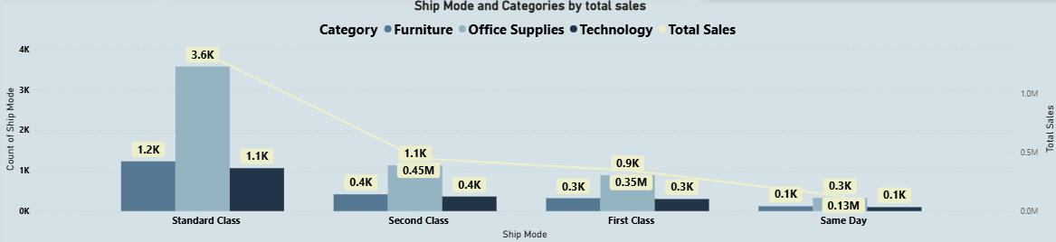
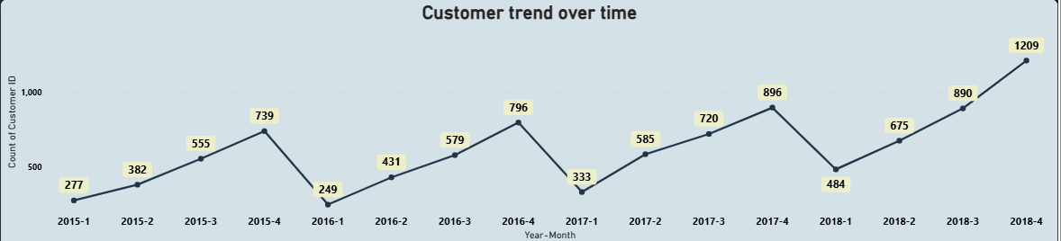
lysis
Customer & Shipping
Shipping Preferences
Standard Class dominates: 3.6K orders (highest volume).
Same Day is least used (only 0.1K orders).
2. Category Performance
Technology leads in sales (highest revenue contribution).
Furniture and Office Supplies show balanced demand.
3. Customer Trends (2015-2018)
Q4 Peaks: Consistent growth in yearly Q4 (holiday season impact).
2018 Surge: Notable increase in orders (esp. Q3-Q4).

Slide 23
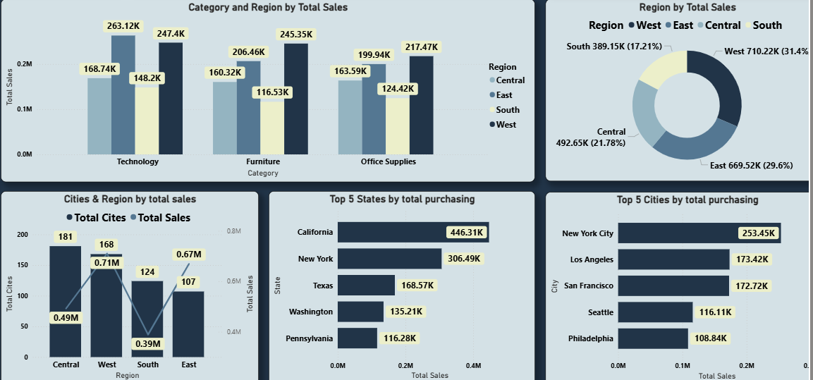
lysis
Region

Slide 24
lysis
Region
West leads with 31.4% of total sales ($710K), followed by East (29.6%).
South has lowest share (17.21%)—opportunity for growth.
2. Category Performance
Technology dominates sales (highest revenue).
Furniture and Office Supplies show balanced performance.
3. Top States & Cities
California (446K) and New York (446K) and New York (306K) are top states.
New York City (253K)and Los Angeles (253K)and Los Angeles (173K) drive urban sales.

Slide 25
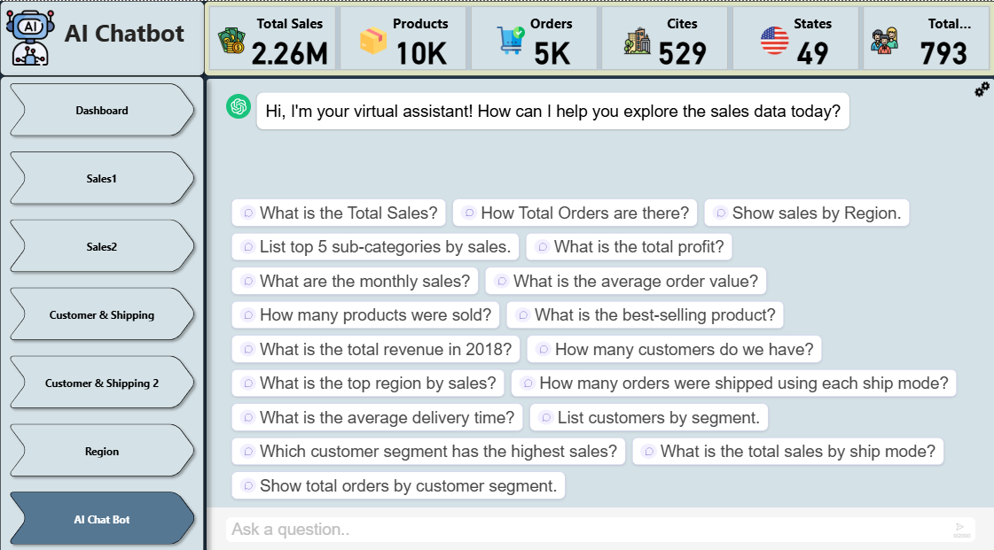
lysis
AI-Powered Sales Insights Dashboard

Slide 26

lysis
Recommendations for Business Growth
Focus on Underperforming Regions
Problem:
South region contributes only 17.21% of total sales Recommendation:
Targeted marketing campaigns in key southern cities (Houston, Atlanta)
Offer regional promotions (e.g., "Southern Summer Sale")
Expected Impact:
10-15% sales increase within 6 months

Slide 27
lysis
Recommendations for Business Growth
Product Bundle Strategy
Problem:
Low-margin products (Binders, Machines) dragging profitability Recommendation:
Create high-value bundles (e.g., "Office Starter Pack")
Implement flash sales for slow-moving inventory Expected Impact:
20% boost in product category sales

Slide 28
lysis
Recommendations for Business Growth
Maximize Peak Seasons
Opportunity:
Q4 accounts for 25% of annual revenue Recommendation:
Launch Black Friday campaigns 2 weeks earlier
Introduce "Spend & Save" tiered discounts Expected Impact:
30% Q4 revenue growth

Slide 29
lysis
Recommendations for Business Growth
Shipping Experience Upgrade
Current State:
Only 20% use premium shipping options Recommendation:
Free expedited shipping for orders >$150
Highlight shipping options at checkout Expected Impact:
25% adoption of premium shipping

Slide 30
lysis
Recommendations for Business Growth
Customer Retention Program
Opportunity:
Top 10 customers drive disproportionate revenue Recommendation:
Launch loyalty program with VIP tiers
Personalized anniversary discounts Expected Impact:
15% increase in repeat purchases

Slide 31

Thank You!
Presented by: Digital Egypt Pioneers Team

